Slide 1
System Analysis and Design
CIT-222 sessional

Slide 2
Submitted By / Team members:
ID: | Name:
2202017 | Md. Gohora Mamun (Team Leader)
2202075 | Tauhid Shahriar Shourove
2202076 | Md. Nafis Islam

Slide 3
Introduction
The Student Fee Payment System is a web-based platform designed to streamline and digitalize the fee payment process for educational institutions. This system enables students to pay their semester fees securely and conveniently through multiple payment channels, while providing administrators with an efficient tool to manage, verify, and track all financial transactions from a centralized dashboard.
The traditional, manual process of fee collection is often plagued by long queues, paperwork, delayed verification, and a lack of payment flexibility. This project directly addresses these challenges by introducing an automated, transparent, and user-friendly online ecosystem. It eliminates the need for physical presence, reduces administrative overhead, and minimizes errors, ensuring a smoother financial operation for both students and the institution's administration.

Slide 4
What the Project Does
The system allows students to:
Register and log into a personalized dashboard
View pending fees and semester-wise fee structures
Pay fees using multiple methods such as Nagad, bKash, and DBBL
Submit transaction IDs for verification
Track payment status (Pending, Approved, or Rejected)
Resubmit payments if rejected

Slide 5
What the Project Does
For administrators, the system provides:
A secure login and dashboard to monitor pending payments
Tools to verify, approve, or reject transactions
Ability to manage semester fees (add, update, view)
Real-time status updates and record-keeping

Slide 6
How It Works
Student Registration & Login: Students create an account or log in using their credentials.
Fee Viewing & Payment Selection: Students view their pending fees and choose a preferred payment method.
External Payment Processing: Payments are made through integrated mobile financial services (MFS) or banking platforms.
Transaction Submission: Students submit the transaction ID to the system for verification.
Admin Verification: Administrators review and validate payments, updating the status accordingly.
Status Update: Students receive instant updates on their payment status via their dashboard.

Slide 7
Benchmark
Features / Criteria | SUST Online Payment System | DU Sonali Bank e-Payment | Rupali Sure Cash System | My System
Online Payment Support | ✔ | ✔ | ✔ | ✔
Mobile Financial Services (MFS) | ✖ | ✖ | ✔ | ✔
Automatic Payment Verification | ✔ | ✔ | ✔ | ✖
Student Login System | ✔ | ✔ | ✔ | ✔
Shows Pending Fees | ✔ | ✔ | ✔ | ✔
Admin Dashboard | ✔ | ✔ | ✔ | ✔
Full Bank API Integration | ✖ | ✔ | ✖ | ✖
Works Without Standing in Line | ✔ | ✔ | ✔ | ✔
Scalable for Future Upgrades | ✔ | ✔ | ✔ | ✔
Instant Payment Confirmation | ✖ | ✔ | ✔ | ✖
Supports Multiple Payment Methods | ✖ | ✖ | ✔ | ✔

Slide 8
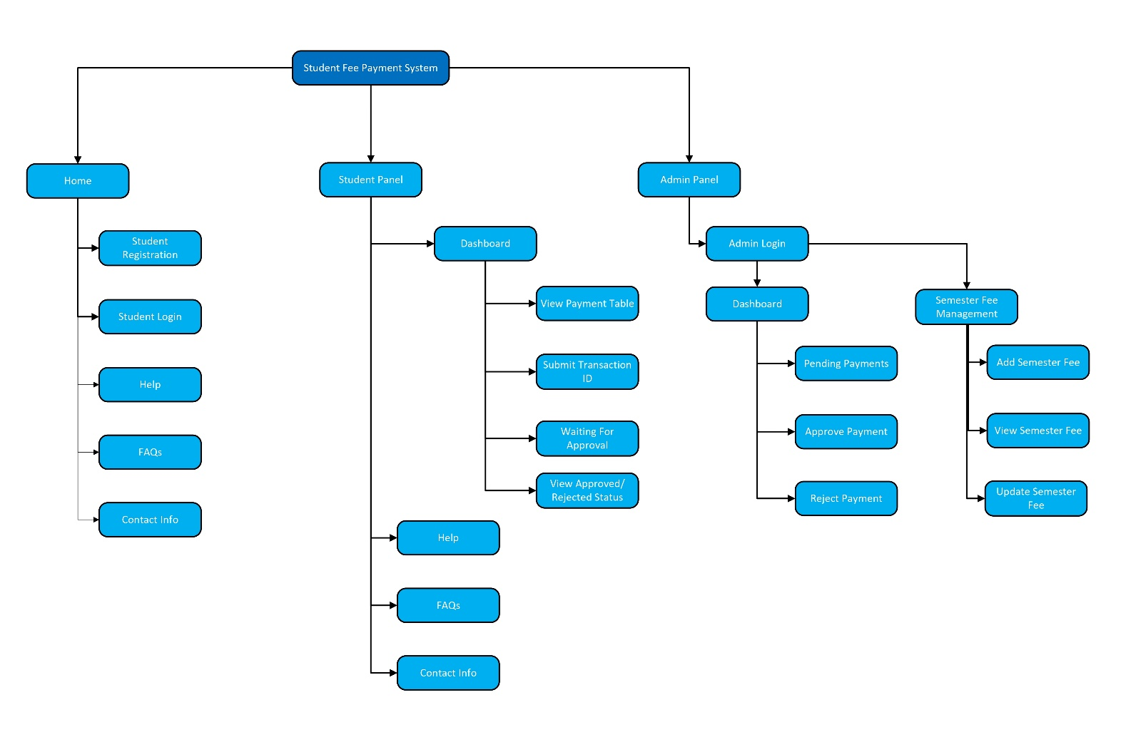
Site Map

Slide 9
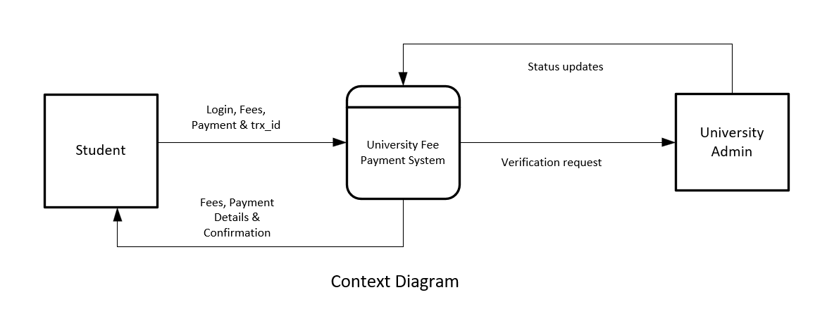
Context Diagram

Slide 10
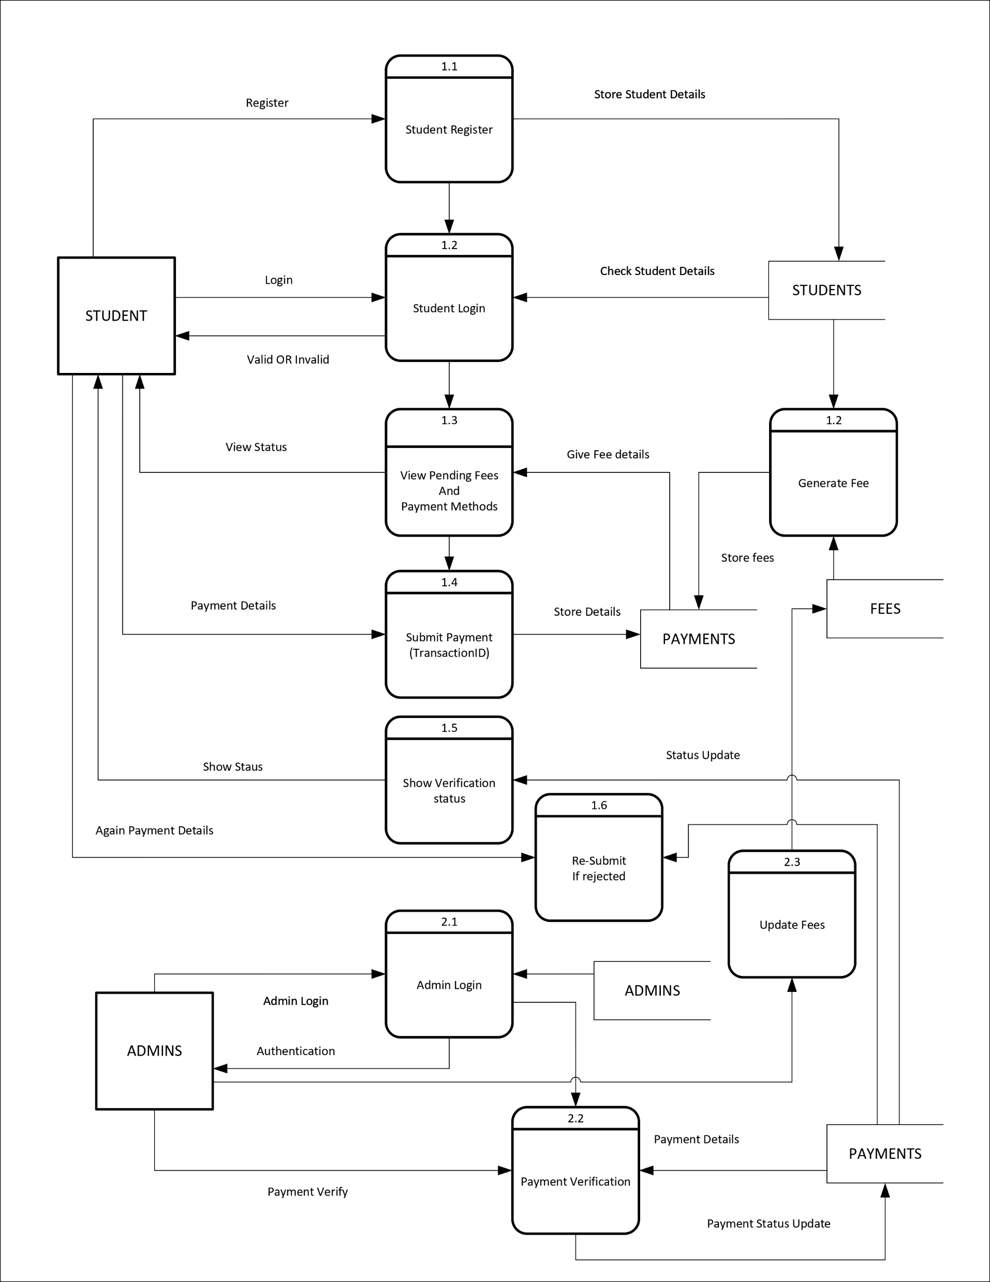
DFD

Slide 11
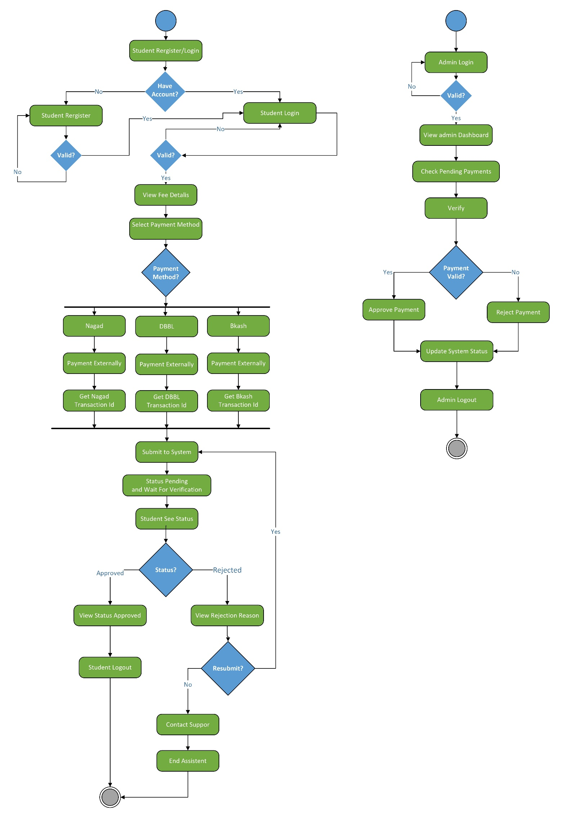
Activity Diagram

Slide 12
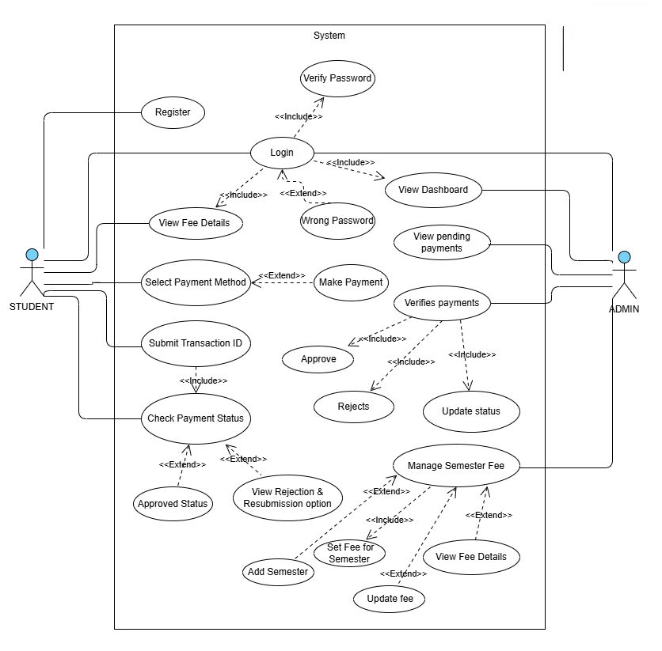
Use Case Diagram

Slide 13
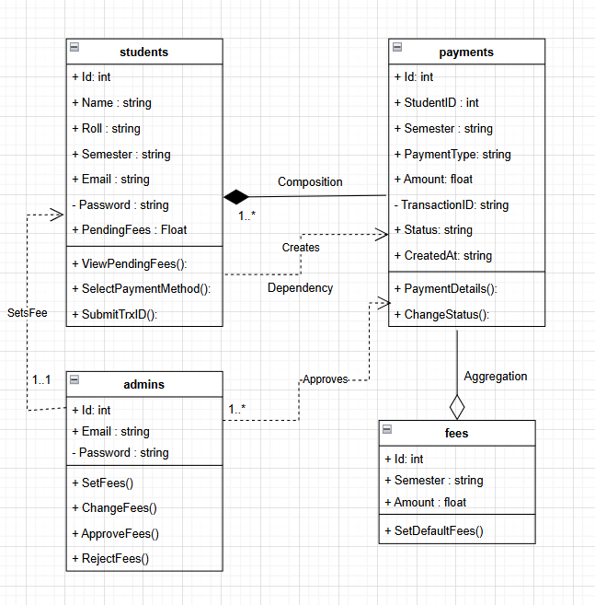
Class Diagram

Slide 14
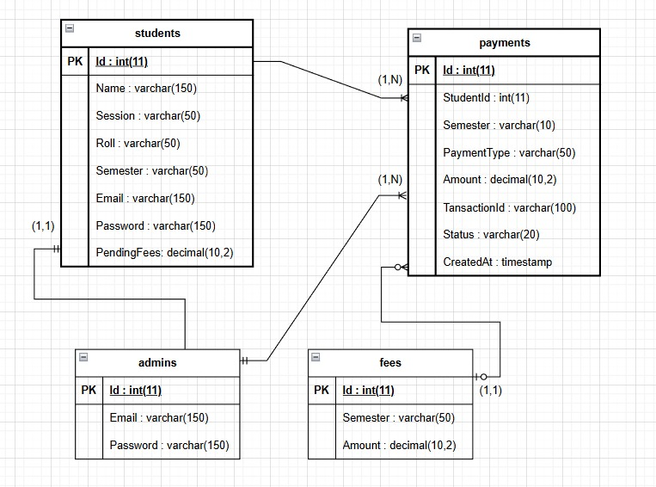
E-R Diagram

